Slide 1

Practice Your Programming with Katas
Session 1: Does the Red Robin Crow at Dusk?

Slide 2

About this Course
Who am I?
Who are you?
Course Aims

Slide 4
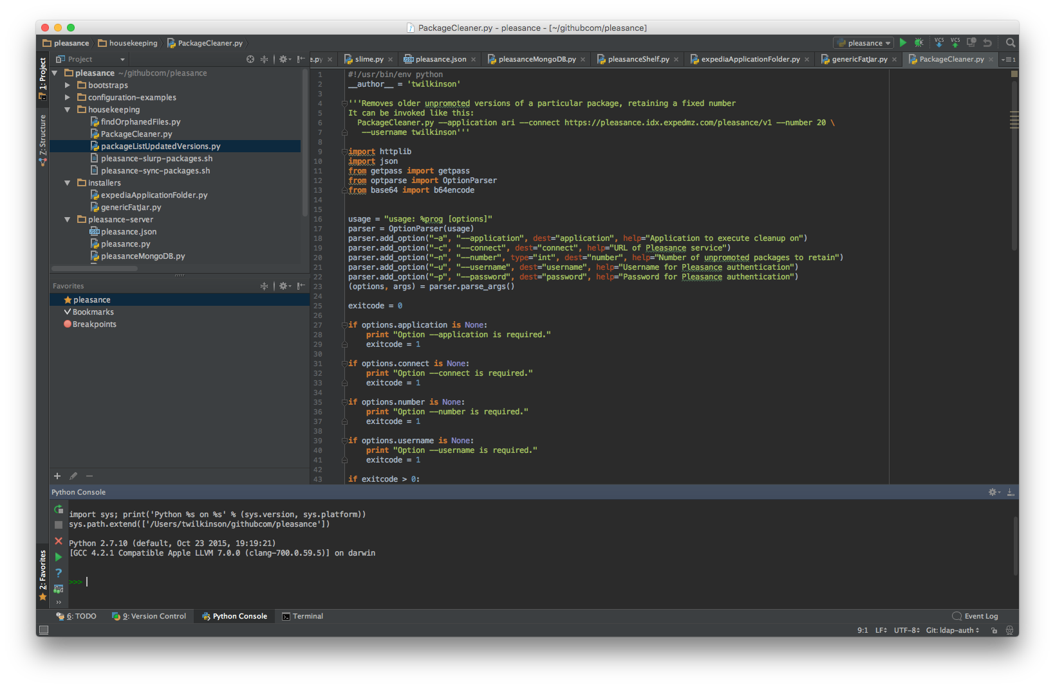
Recap: What do we need?
Your language of choice
An IDE / editor :
Visual Studio Code
Sublime Text
PyCharm Community Edition
IntelliJ IDEA
… etc
Do not use:
Notepad
Notepad++

Slide 5
What is a Kata?
Repetition
Repetition
Repetition
By performing the same task over and over again, we get better at it

Slide 6
Great. So what is a Kata?
Every week I’ll set you a task to complete.
The task will could derived from a scenario, a puzzle, a game, etc.…
You must come up with a solution that fulfils these requirements:
A single function – takes some input, returns desired output
All unit tests must complete successfully
It should be Pythonic

Slide 8
Pythonic?
We should aim toward Pythonic code.
Maybe even if we’re writing java!
What does Pythonic mean?
import this will tell you the Zen of Python (run that line somewhere!)

Slide 9
Test Driven Development
Big scary concept time:
We define what our program should do (and not do) before we write it
Each session, I’ll supply a set of unit tests. The solution is up to you!
This week’s starter code is here: https://go/eca-katas-1
Run the file containing the tests to check your program works!
Notes:
No, unittest isn’t the best unit testing library out there. But it works out of the box, and does what we need for this course.

Slide 10
How to run your tests?
Python: python session1_tests.py
Java (ensure your class path is set correctly!): javac *.java java TestRunner
Other languages: consult your test framework’s documentation

Slide 11
TDD, Continued…
Don’t edit the tests file
Write your code in redactor.py / redactor.java
Run the tests (previous slide) to test it
Don’t overcomplicate things! ☺
Run the tests file to test your code.
Don’t run redactor directly – it has no main() or equivalent
I reserve the right to add extra unit tests if I think you’re “cheating” and your solution only works for the tests given ☺

Slide 12
Week 1 – Redaction: http://go/eca-katas-1
MI:7 are concerned that some secret details are getting leaked by some do-gooder civil servant. They want to redact sensitive details from any communications.
Write a function that accepts:
A sentence (string)
A list of words that should be redacted (in lower case)
It should return:
The sentence with the appropriate words redacted with ‘****’

Slide 13
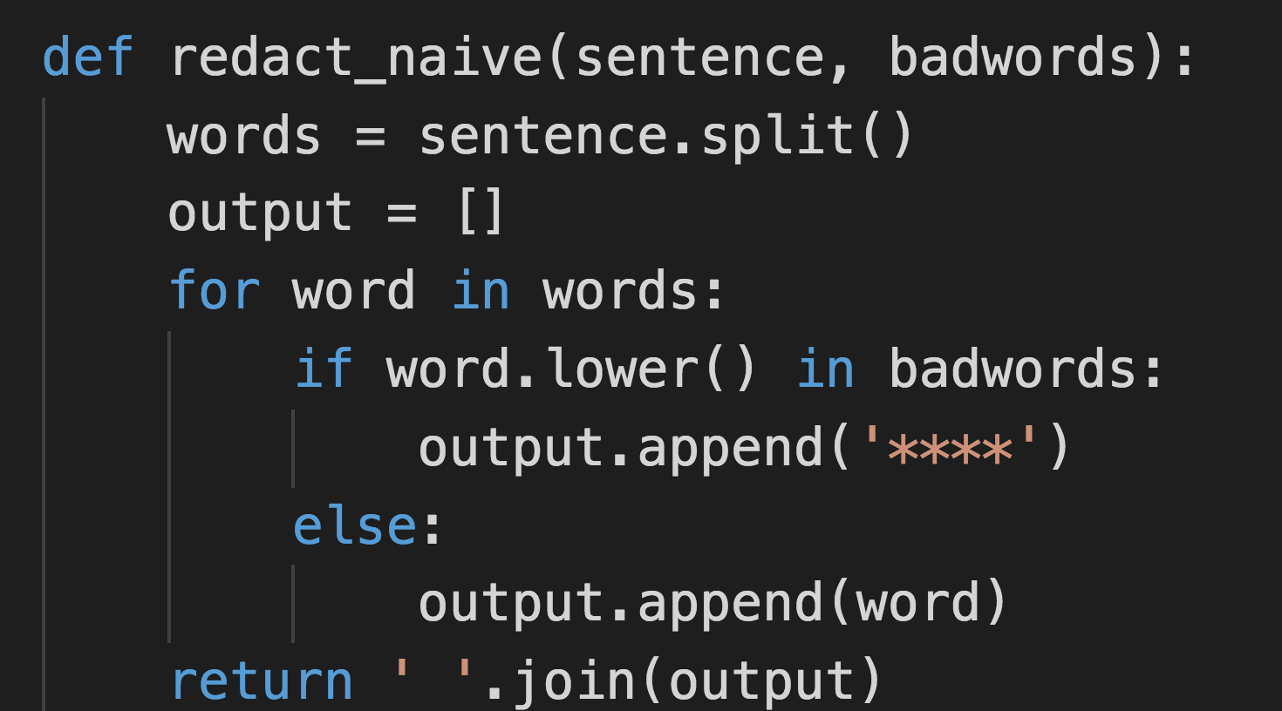
Naïve implementation?

Slide 14
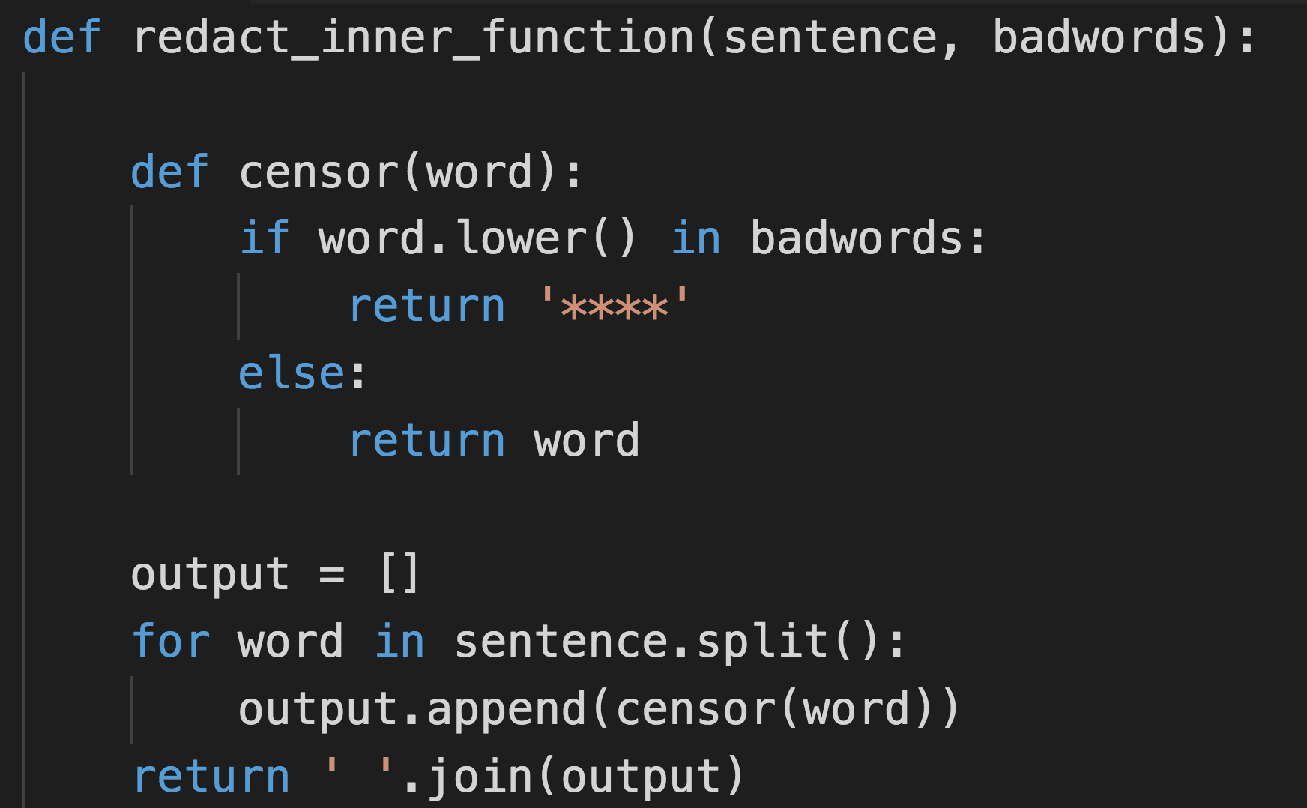
An Inner Function

Slide 15
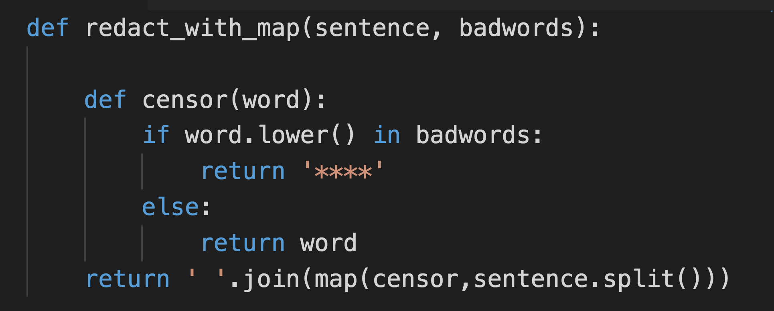
Mapping to the inner function

Slide 16
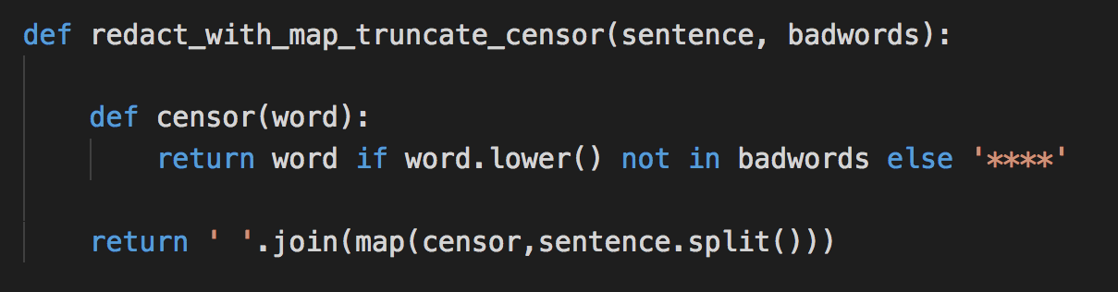
Cutting down the censor

Slide 17
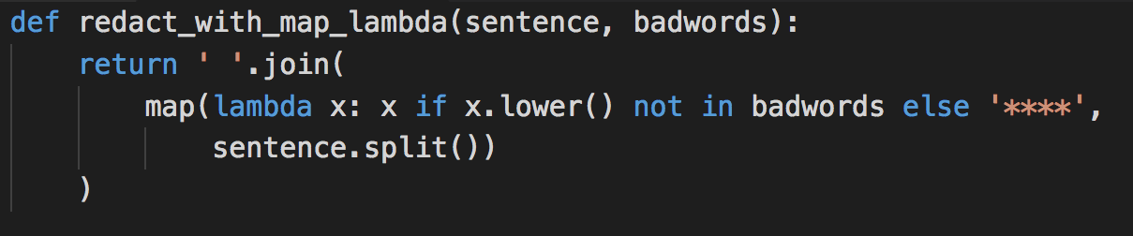
Doing away with the censor
Notes:
Maybe not so readable?

Slide 18
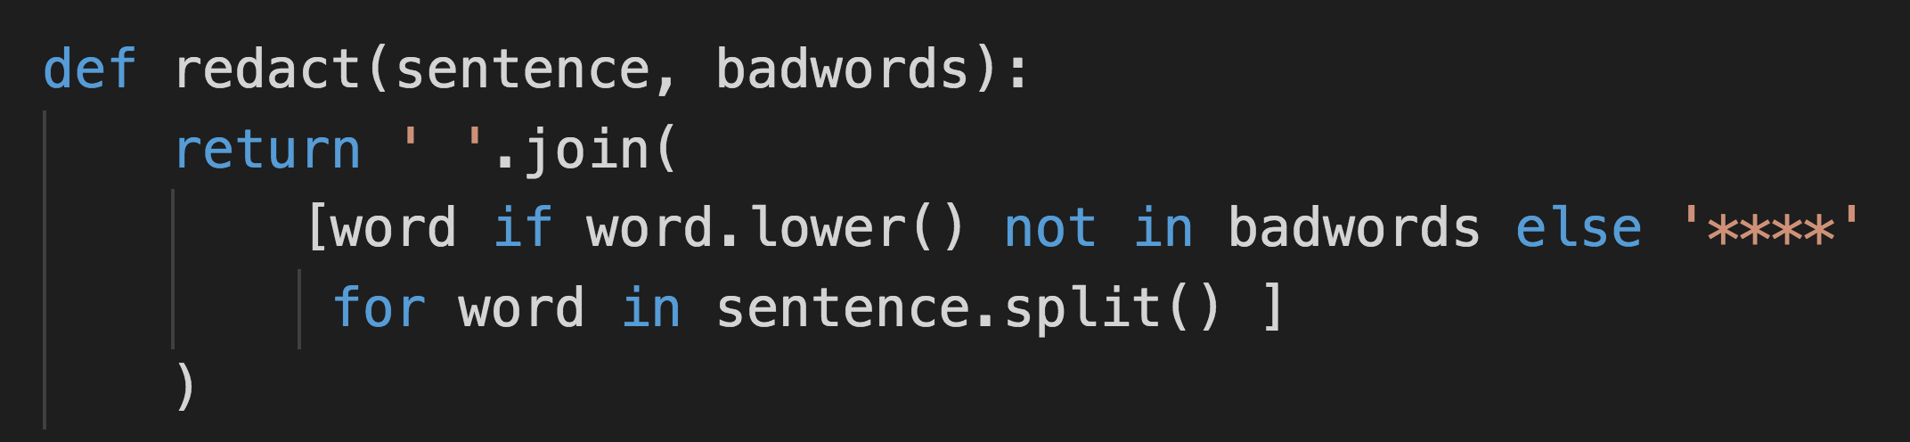
Using List Comprehension

Slide 19
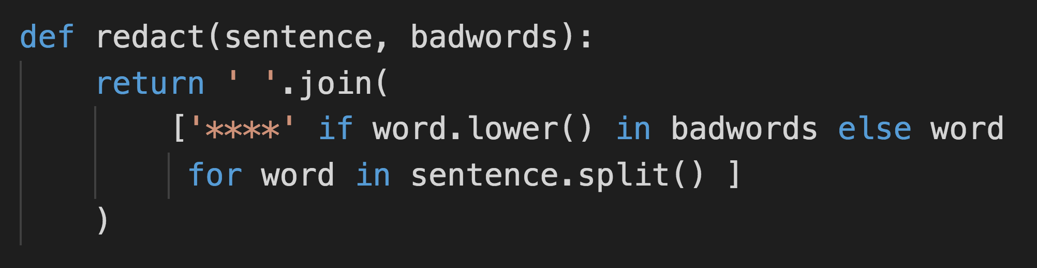
Ac-Cent-Tchu-Ate the Positive

Slide 20
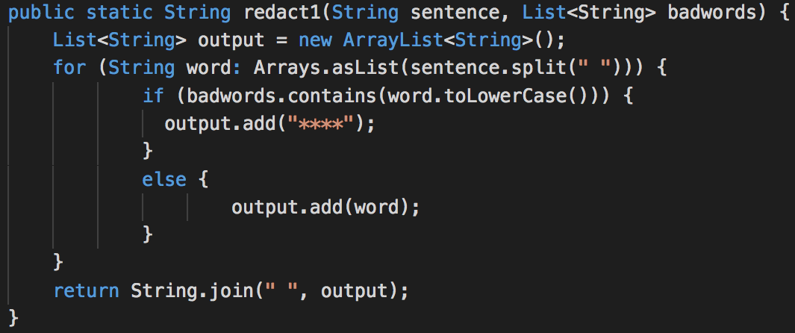
Java-flavoured Naivety

Slide 21
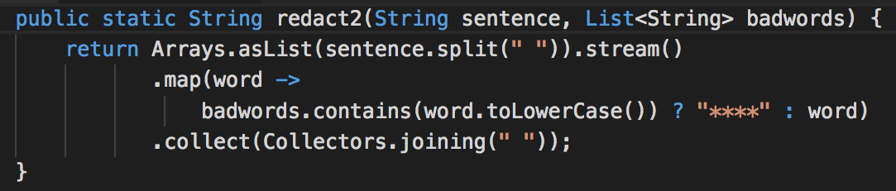
Collectors and Lambdas and streams! Oh my!

Slide 22
Next time:
Cursing recursion?

